Slide 1
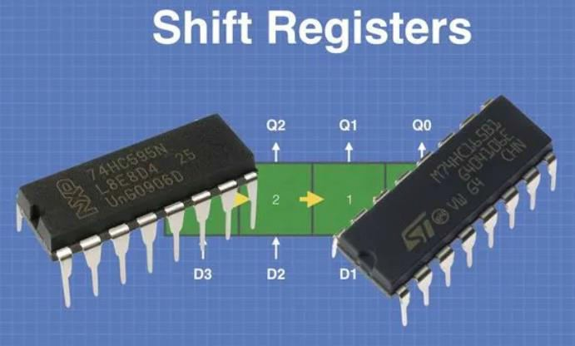
Programming and Connection of Shift Register
Shift registers are the handy devices that are used for all sorts of purposes like data conversion, buffering and storage.

Slide 2
Why do we need shift registers?
Arduino’s have a number of digital I/O ports already, in fact, the Arduino Mega 250 boasts 54 digital I/O pins plus another 16 analog inputs that can double as digital I/O pins. So, with 70 potential I/O pins you don’t usually have a need for more. But sometimes you actually do need more.
Take the familiar “LED Cube”. A cube with a 4x4x4 dimension would require 64 LEDs, within the capability of an Arduino Mega 2560 if you “borrow” a few analog pins. But you’re nearly at the limit. If you wanted to expand to a 5x5x5 cube then you’re out of luck, you’ll need 125 LEDs for that and you can’t control them individually with one Arduino.
Even a 4x4x4 cube using standard (i.e. non-addressable) RGB LEDs would put you past the limit.
There are many ways to solve these issues, including running the LEDs in a matrix or using a shift register. The shift register will allow you to address a large number of LEDs using only a few Arduino I/O pins.

Slide 3
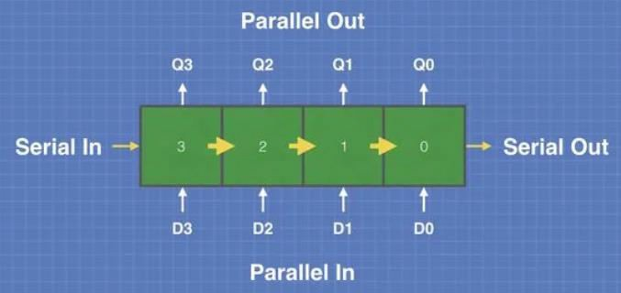
There are other times when you have a lot of sensors, displays or other I/O devices and can’t spare a lot of pins for LEDs or switches, but you need a multi-LED display or a small keypad. Again shift registers can come to the rescue. Let’s examine these handy devices.
Shift Registers
Shift Registers are sequential logic circuits that are used for the conversion, storage or transfer of binary data.

Slide 4
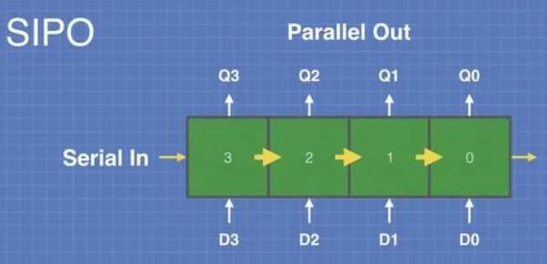
These devices are used to convert between serial and parallel data. They can be used in data communications circuits as well as memory and buffer circuits. Many complex electronic circuits, such as microprocessors and microcontrollers, use shift registers internally.
Types of Shift Registers
Shift registers deal with both serial and parallel data on both their inputs and outputs and they can convert between these formats. There are four basic types of shift registers:
Serial In – Parallel Out
The Serial In – Parallel Out (SIPO) shift register converts serial data to parallel data. It is used in communications and to drive multiple output ports using serial data.

Slide 5
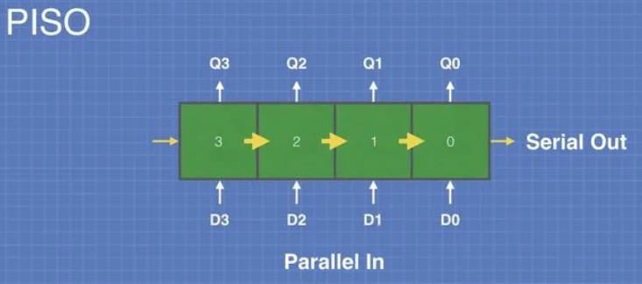
Parallel In – Serial Out
The Parallel In – Serial Out (PISO) shift register converts parallel data to serial data. It is used in communications and to convert multiple input ports to serial data.

Slide 6
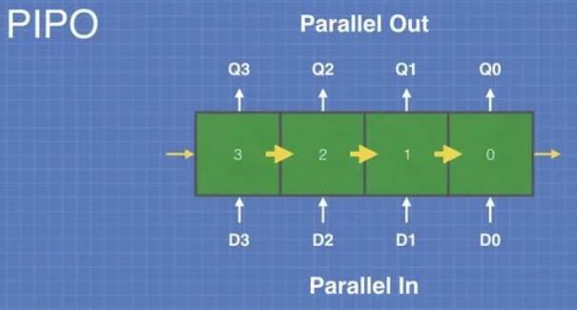
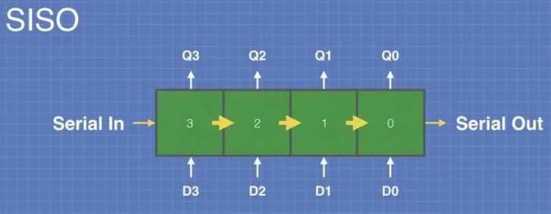
Parallel In – Parallel Out & Serial In – Serial Out
You might find these two strange. Why would you want a shift register that outputs data in the same format that it was input?
The answer is that this can be used as a buffer, to hold data for a specific number of clock cycles. The shift registers we are using today both employ similar buffers to hold data on their inputs and outputs so it doesn’t change while the register is being shifted through.

Slide 7
74HC595 & 74HC165 Shift Registers
We will be using two very common and easily obtained shift registers today, the 74HC595 SIPO and 74HC165 PISO. Let’s take a closer look at these chips.
74HC595 – 8-bit Serial In – Parallel Out
The 74HC595 is an 8-stage serial shift register that also has an internal storage register. The storage register buffers the output data and can be clocked independently of the shift register. This prevents the data from changing while it is being loaded.
The 74HC595 has a “3-state” output. This means that the pins on the parallel data output can be at three different states.
LOW
HIGH
OFF
The OFF state is a high-impedance state that effectively disconnects the output of the chip. This technique allows several 3-state chips to drive the same bus, with only one of them active at any given time.

Slide 8
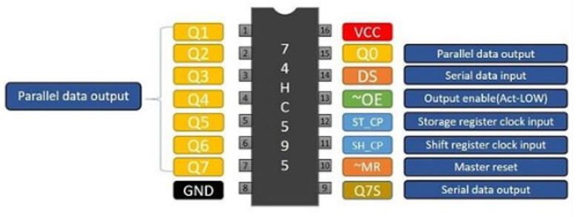
The pinout of the 74HC595 in the DIP package is illustrated here:
The serial data is input on the DS pin (pin 14). You can use the Q7S pin to cascade these devices to increase the number of parallel outputs you can control.
The Output Enable (pin 13) controls the 3-state bus, if it is LOW then the output bus is enabled.

Slide 9
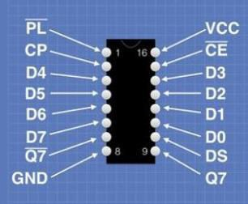
74HC165 – 8-bit Parallel In – Serial Out
The 74HC165 is an 8-bit parallel-load shift register which has a serial output. It has complementary outputs, one of which can be tied to another 74HC165 to cascade them.
This device is used for parallel to serial data conversion and has the following pinout:

Slide 10
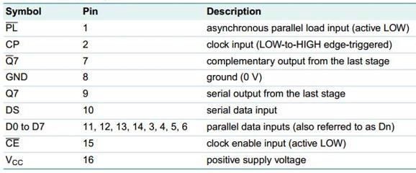
As with the 74HC595, this is a very common integrated circuit and you should have no trouble obtaining it at almost any electronics supplier.
Extra Output Ports with the 74HC595
We will begin our experiments with the 74HC595 SIPO (Serial In – Parallel Out) shift register. The 74HC595 allows us to expand the number of digital I/O ports on our Arduino. In these experiments, we will be using it to drive some LEDs, which we will control using an Arduino.

Slide 11
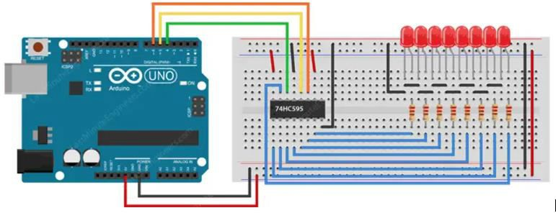
Arduino & 74HC595 Hookup
Here is how we will be hooking up the 74HC595 to an Arduino and to eight LEDs.
Start by putting the shift register on your breadboard. Make sure that each side of the IC is on a different side of the breadboard. With the little U-shaped notch facing up, pin 1 of the chip is to the left of this notch.

Slide 12
Connect pins 16 (VCC) and 10 (SRCLR) to the Arduino’s 5V output, and pins 8 (GND) and 13 (OE) to the ground. This should keep the IC in the normal working mode.
Next, connect the three pins that will be used to control the shift register. Connect pin 11 (SRCLK), pin 12 (RCLK), and pin 14 (SER) of the shift register to the Arduino’s pins 6, 5, and 4, respectively.
All that remains is to connect the LEDs to the output pins. Connect the cathode (short pin) of
each LED to a common ground, and the anode (long pin) of each LED to its respective shift register output pin.
Don’t forget to add a 220Ω resistor in series to protect the LEDs from being overloaded. When connecting the LEDs, ensure that QA is connected to the first LED and QH is connected to the last; otherwise, the LEDs will not light up in the correct order!
There are a lot of wires here so double-check your wiring. You may test the LED-dropping
resistor combos by wiring them first and then applying 5 volts to the resistor, if it is wired correctly, you’ll light the LED. Repeat the test for all eight resistor-LED pairs. Do this before you wire up the 74HC595 and the Arduino.
Once it is all wired up you can move forward and write some code to make it all work.

Slide 13
Arduino shiftOut() Function
There are a couple of ways to “talk” to a shift register with an Arduino. One way is to use the SPI bus, which would allow you to make use of existing libraries to simplify writing code. Another way is to use any standard I/O pins on the Arduino to create a clock and to exchange serial data. This is the method we will employ to work with the 74HC595 shift register.
Arduino provides a shiftOut() function to simplify moving data on a serial connection. It can take
a byte value and output it in a serial format in sync with a clock pulse on another pin. You can choose to output the data in two directions.
MSB First – The Most Significant Bit first. So the binary number 10110010 will output a bit at a time starting with “101”, or from left to right.
LSB First – The Least Significant Bit first. In this case, the binary number 10110010 will output a bit at a time starting with “010”, or from right to left.

Slide 14
Arduino & 74HC595 Code
Our sketch is pretty simple. The shiftOut function takes care of sending our data to the shift register and of creating a clock signal.
int latchPin = 5; // Latch pin of 74HC595 is connected to Digital pin 5
int clockPin = 6; // Clock pin of 74HC595 is connected to Digital pin 6
int dataPin = 4; // Data pin of 74HC595 is connected to Digital pin 4
byte leds = 0; // Variable to hold the pattern of which LEDs are currently turned on or off

Slide 15
/*
setup() - this function runs once when you turn your Arduino on
We initialize the serial connection with the computer
*/
void setup()
{
// Set all the pins of 74HC595 as OUTPUT
pinMode(latchPin, OUTPUT);
pinMode(dataPin, OUTPUT);
pinMode(clockPin, OUTPUT);
}

Slide 16
/*
* loop() - this function runs over and over again
*/
void loop()
{
leds = 0; // Initially turns all the LEDs off, by giving the variable 'leds' the value 0
updateShiftRegister(); delay(500);
for (int i = 0; i < 8; i++) // Turn all the LEDs ON one by one.
{
bitSet(leds, i); // Set the bit that controls that LED in the variable 'leds’
updateShiftRegister();
delay(500);
}
}

Slide 17
/*
* updateShiftRegister() - This function sets the latchPin to low, then calls the Arduino function 'shiftOut' to shift out contents of variable 'leds' in the shift register before putting the 'latchPin' high again.
*/
void updateShiftRegister()
{
digitalWrite(latchPin, LOW); shiftOut(dataPin, clockPin, LSBFIRST, leds); digitalWrite(latchPin, HIGH);
}

Slide 18
Code Explanation
The first step is to define the three control pins of the 74HC595, namely the latch, clock, and data pin, which are connected to the Arduino’s digital pins #5, #6, and #4, respectively.
int latchPin = 5;
int clockPin = 6;
int dataPin = 4;
Next, a variable called leds of datatype byte is defined. The byte datatype can store eight bits, which is ideal for tracking the on/off status of eight LEDs.
// Variable to hold the pattern of which LEDs are currently turned on or off
byte leds = 0;

Slide 19
In the ‘setup’ function, we simply configure the three pins to be digital output.
void setup()
{
pinMode(latchPin, OUTPUT);
pinMode(dataPin, OUTPUT); pinMode(clockPin, OUTPUT);
}
The loop function first turns off all the LEDs by setting all the bits of the variable leds to 0 and calling a custom function updateShiftRegister(). The program pauses for half a second before counting from 0 to 7 using the for loop and the variable i.
During each iteration, the built-in function bitSet() is called to set the bit in the variable leds that controls a particular LED, and the function updateShiftRegister() is called to change the status of LEDs. Then there is a half-second delay before incrementing i and turning on the next LED.

Slide 20
The function updateShiftRegister() first sets the latch pin to LOW and then calls the built-in function shiftOut() before setting the latch pin to HIGH again.
The Arduino IDE includes a shiftOut() function that is designed specifically for shift registers. This function allows us to shift out a byte of data one bit at a time. The shiftOut() function accepts four inputs, the first two of which are Data and Clock pins. The third parameter specifies whether the bits should be shifted out in MSBFIRST or LSBFIRST order (Most Significant Bit First, or, Least Significant Bit First). The final parameter is the actual data to be shifted out, in this case leds.
Setting the latch pin to HIGH copies the contents of the Shift Register into the Storage/Latch Register. Notice that we set the latch pin LOW before shifting bits because, if we don’t, the wrong LEDs would flicker while data is being loaded into the shift register.

Slide 21
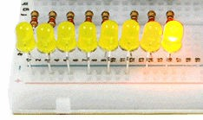
Result
After uploading the code to the Arduino, you should see the following output:

